Slide 1

CS589-04 Digital Image Processing
Lecture 5. Morphological Image Processing
Spring 2008
New Mexico Tech

Slide 2
Introduction
Morphology: a branch of biology that deals with the form and structure of animals and plants
Morphological image processing is used to extract image components for representation and description of region shape, such as boundaries, skeletons, and the convex hull

Slide 3
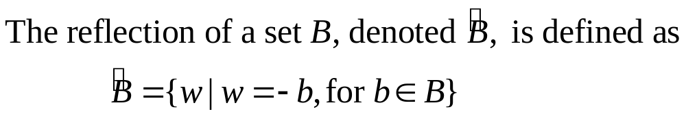
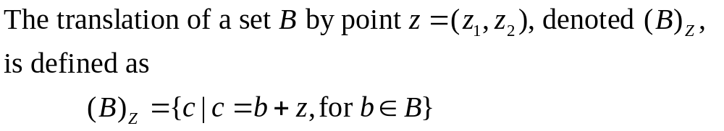
Preliminaries (1)
Reflection
Translation

Slide 4
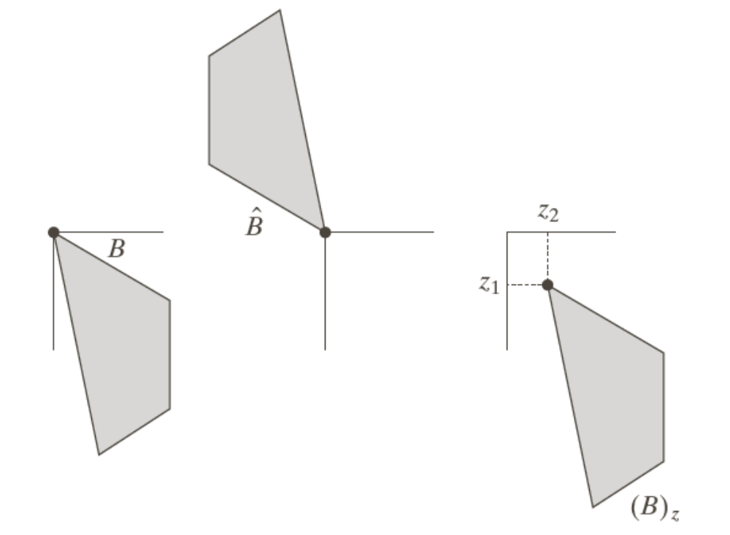
Example: Reflection and Translation

Slide 5
Preliminaries (2)
Structure elements (SE)
Small sets or sub-images used to probe an image under study for properties of interest

Slide 6
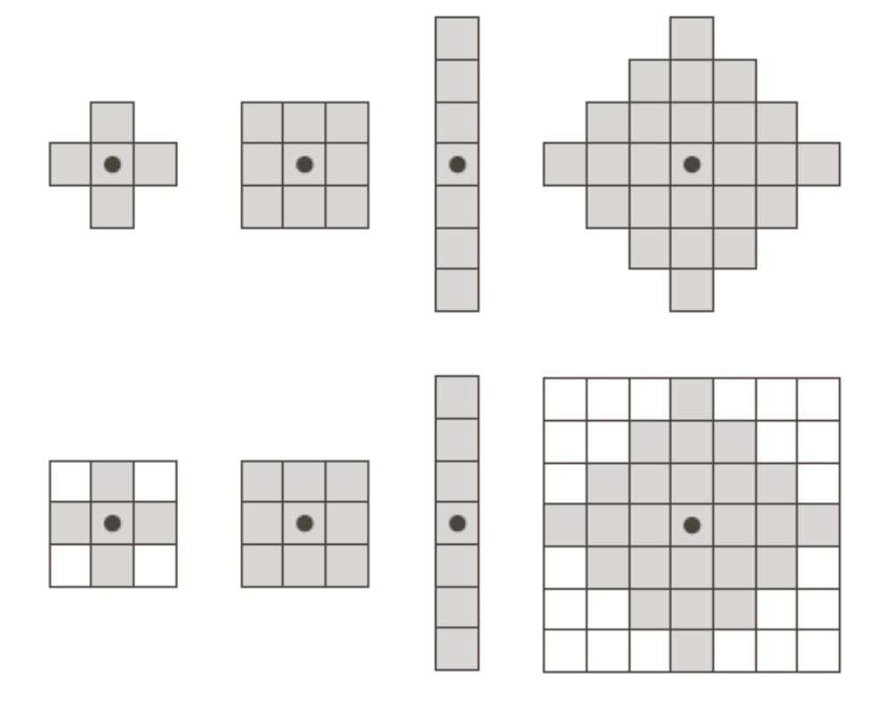
Examples: Structuring Elements (1)
origin

Slide 7
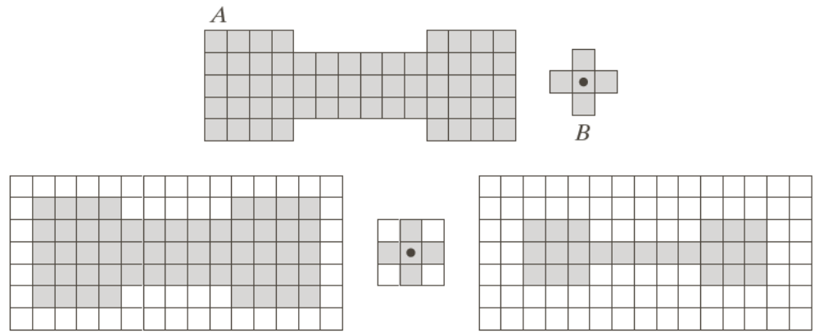
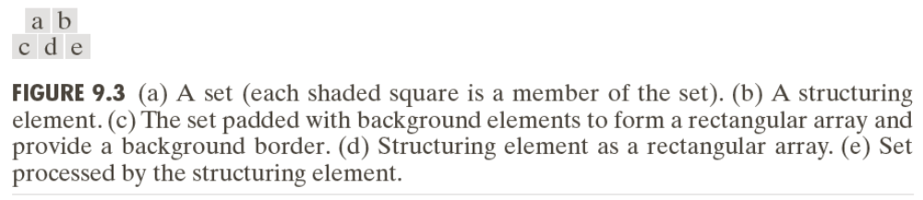
Examples: Structuring Elements (2)
Accommodate the entire structuring elements when its origin is on the border of the original set A
Origin of B visits every element of A
At each location of the origin of B, if B is completely contained in A, then the location is a member of the new set, otherwise it is not a member of the new set.

Slide 8
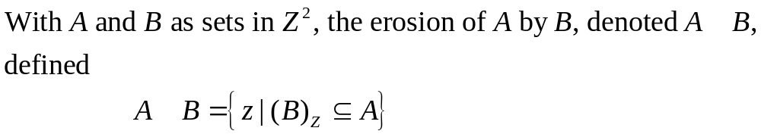
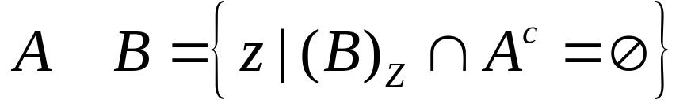
Erosion

Slide 9
Example of Erosion (1)

Slide 10
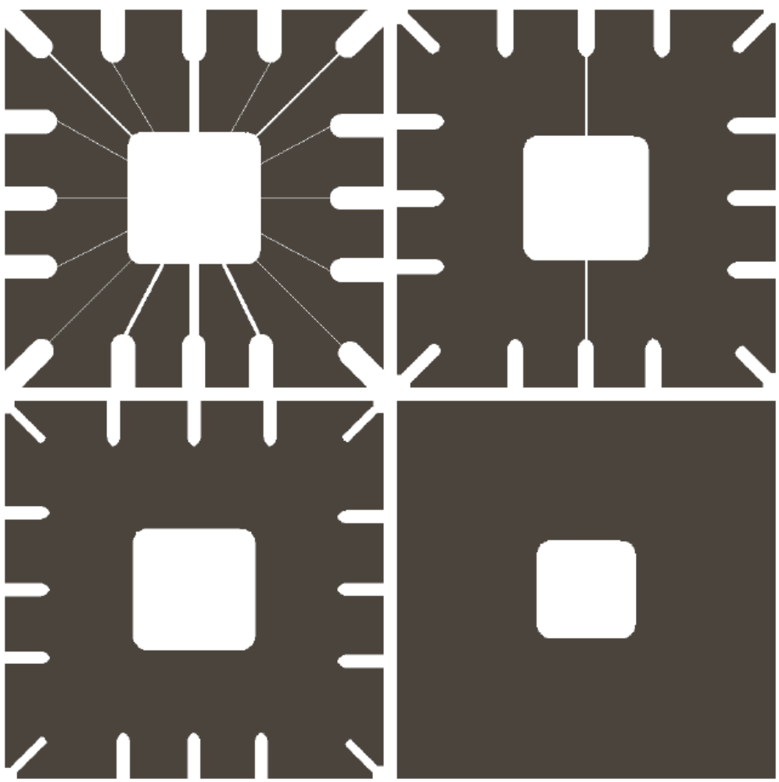
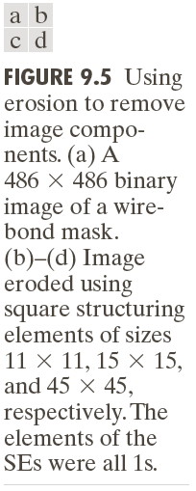
Example of Erosion (2)

Slide 11
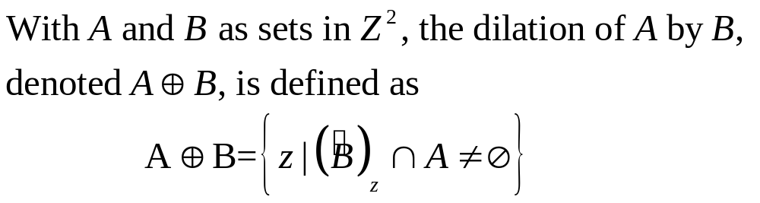
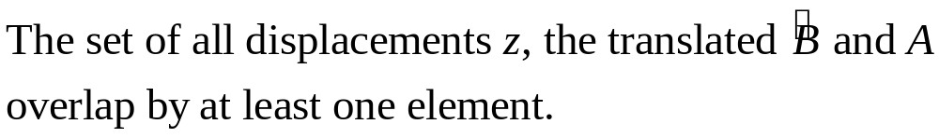

Dilation

Slide 12
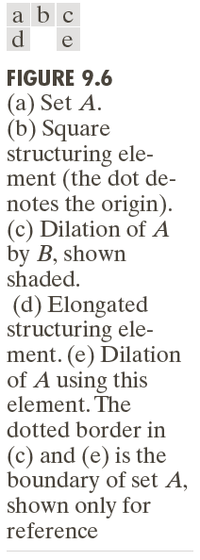
Examples of Dilation (1)

Slide 13
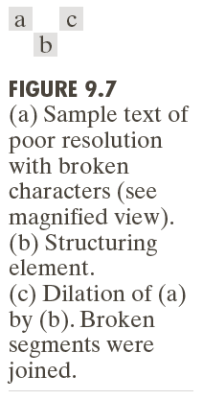
Examples of Dilation (2)

Slide 14
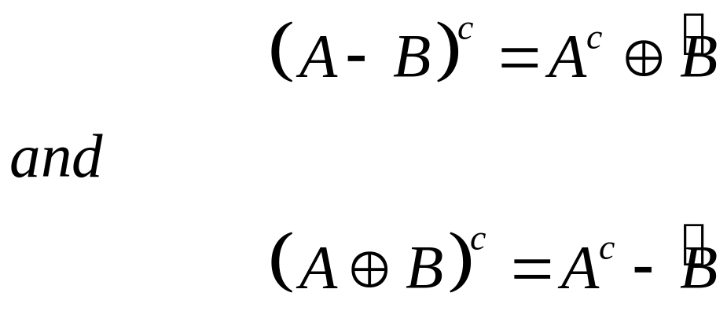
Duality
Erosion and dilation are duals of each other with respect to set complementation and reflection

Slide 15
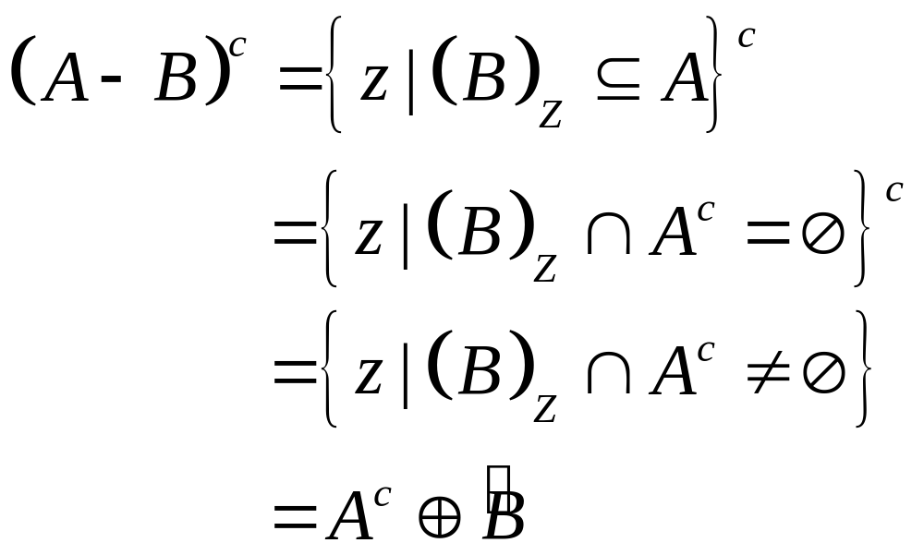
Duality
Erosion and dilation are duals of each other with respect to set complementation and reflection

Slide 16
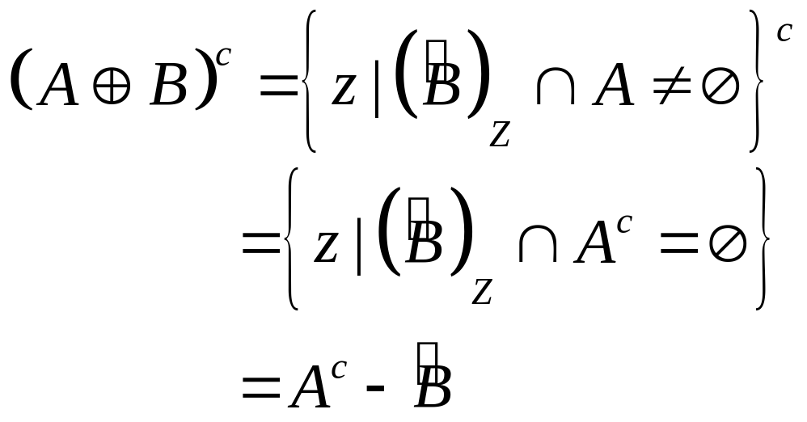
Duality
Erosion and dilation are duals of each other with respect to set complementation and reflection

Slide 17
Opening and Closing
Opening generally smoothes the contour of an object, breaks narrow isthmuses, and eliminates thin protrusions
Closing tends to smooth sections of contours but it generates fuses narrow breaks and long thin gulfs, eliminates small holes, and fills gaps in the contour

Slide 18
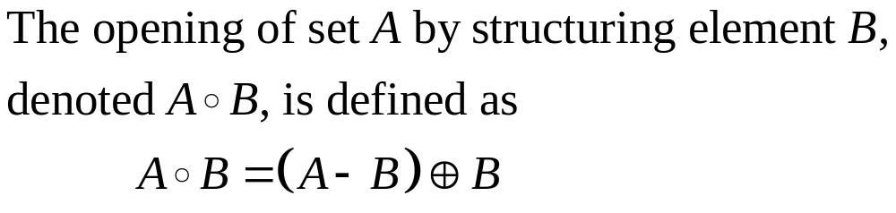
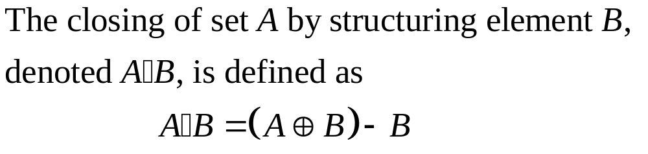
Opening and Closing

Slide 19
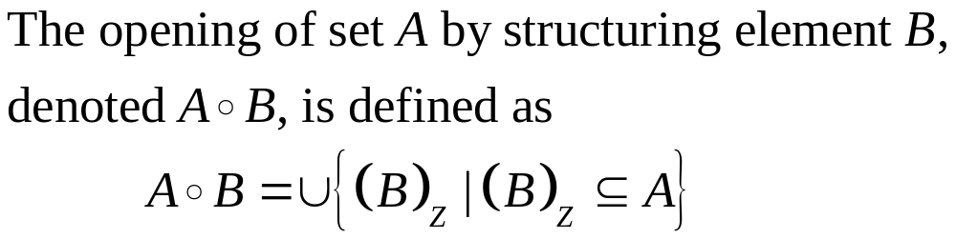
Opening

Slide 20
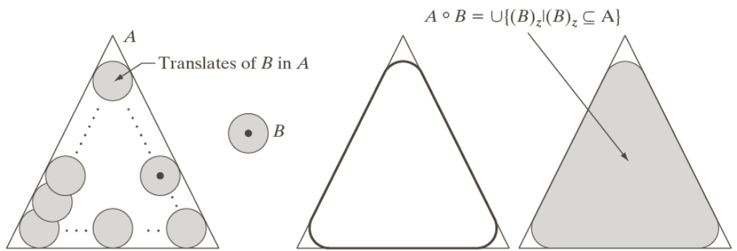
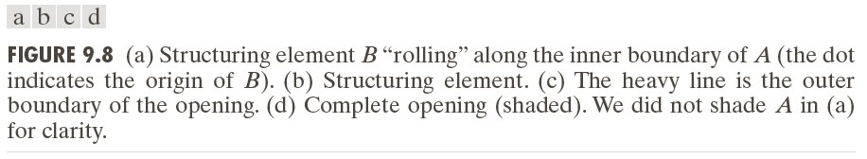
Example: Opening

Slide 21
Example: Closing

Slide 22
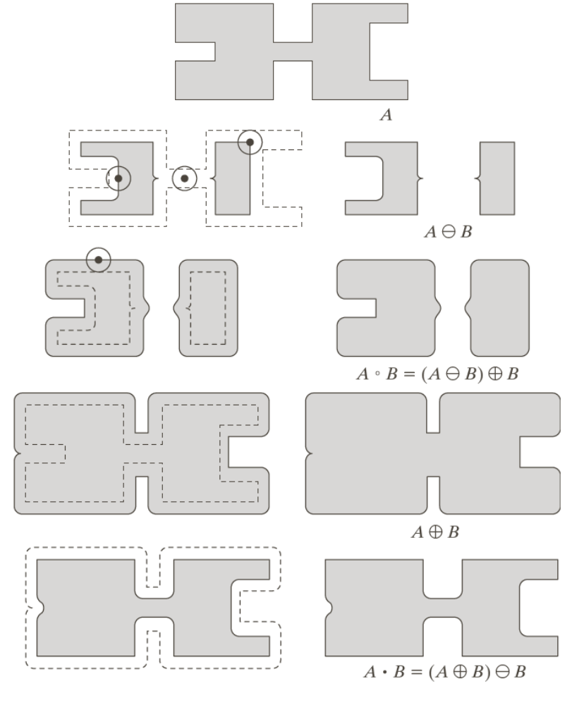

Slide 23

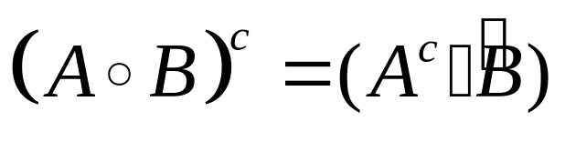
Duality of Opening and Closing
Opening and closing are duals of each other with respect to set complementation and reflection

Slide 24
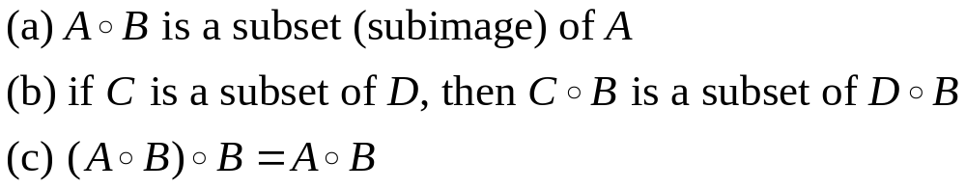
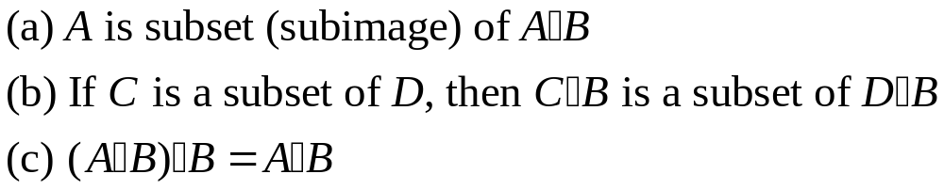
The Properties of Opening and Closing
Properties of Opening
Properties of Closing

Slide 25
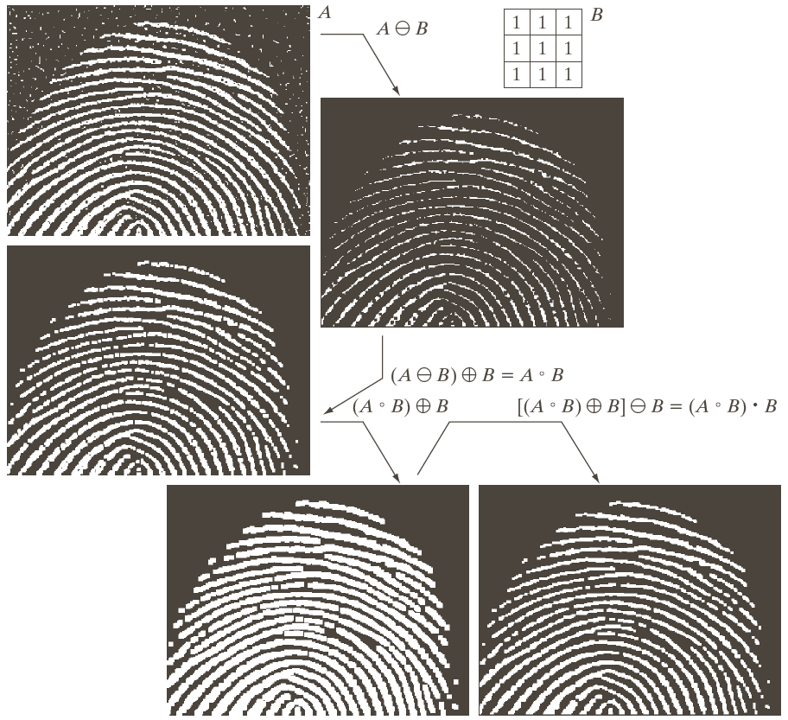
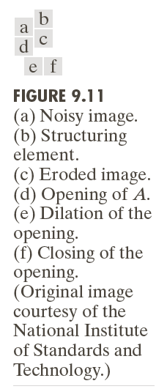

Slide 26
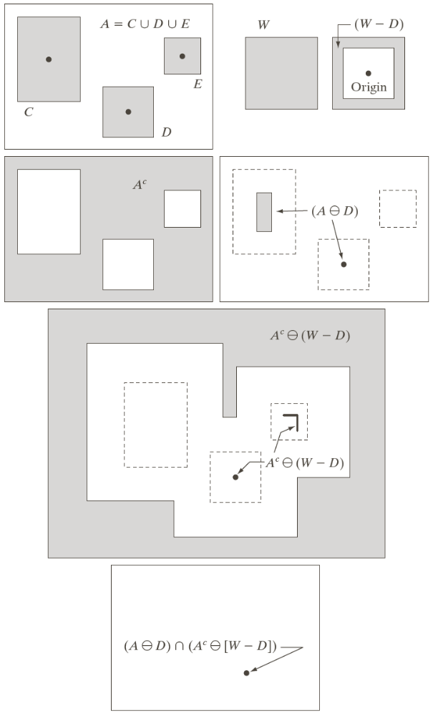
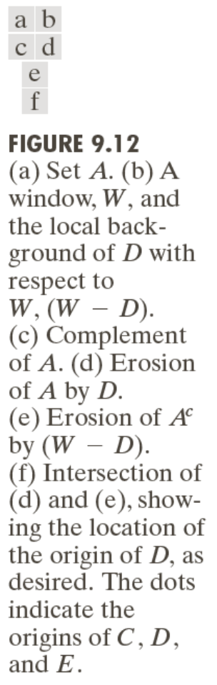
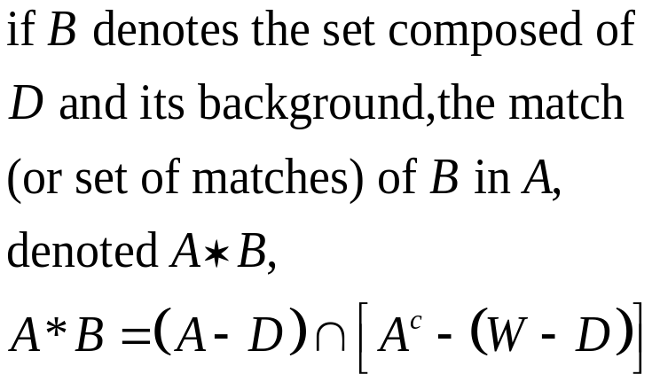
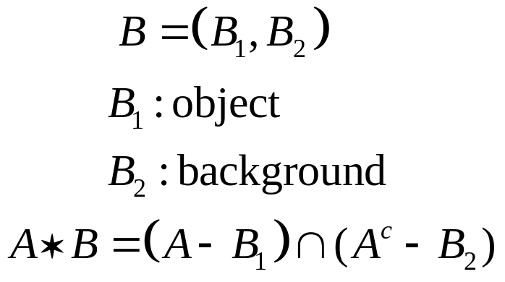
The Hit-or-Miss Transformation

Slide 27
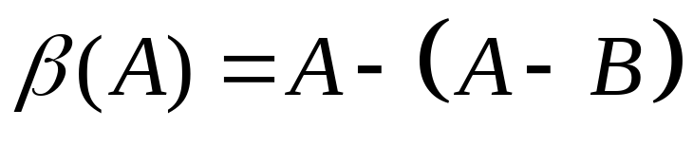
Some Basic Morphological Algorithms (1)
Boundary Extraction
The boundary of a set A, can be obtained by first eroding A by B and then performing the set difference between A and its erosion.

Slide 28
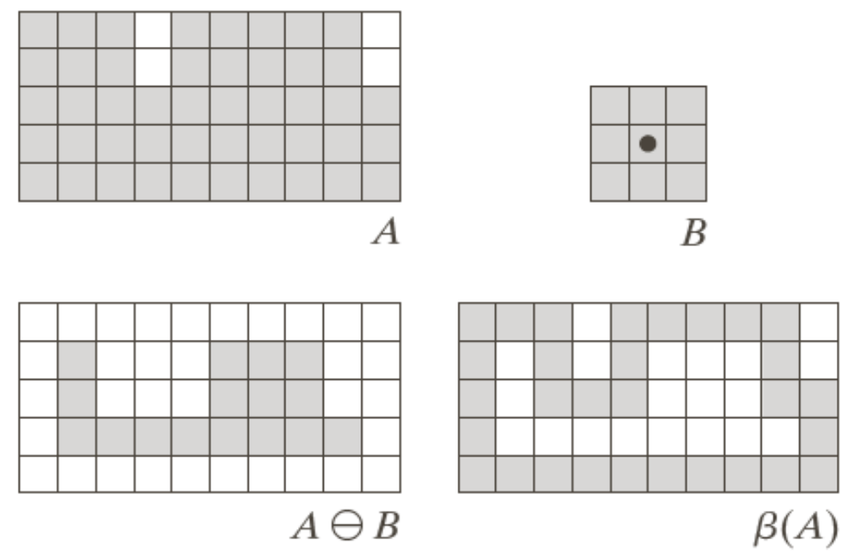
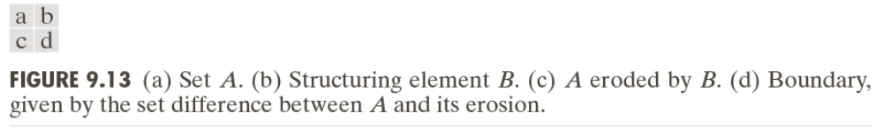
Example 1

Slide 29
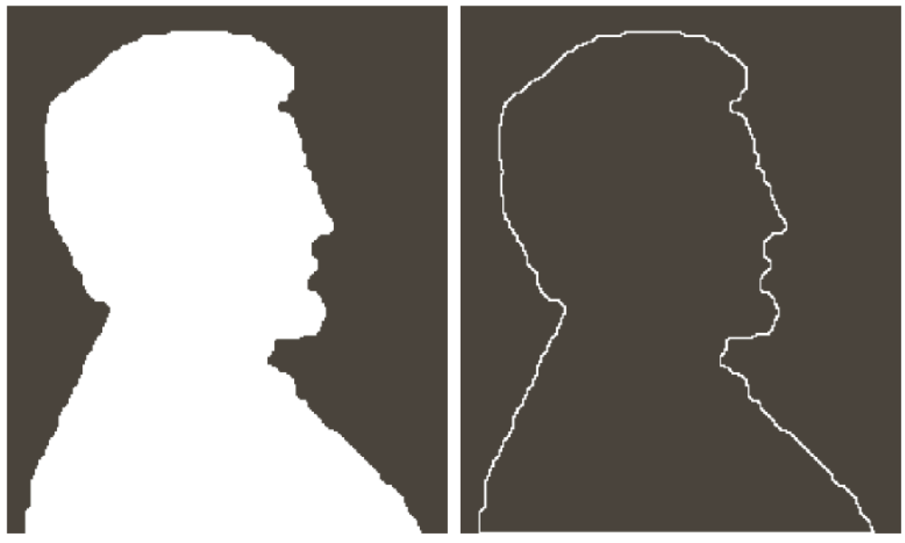
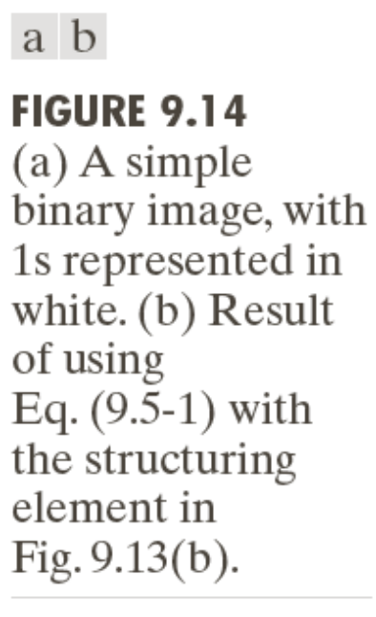
Example 2

Slide 30
Some Basic Morphological Algorithms (2)
Hole Filling
A hole may be defined as a background region surrounded by a connected border of foreground pixels.
Let A denote a set whose elements are 8-connected boundaries, each boundary enclosing a background region (i.e., a hole). Given a point in each hole, the objective is to fill all the holes with 1s.

Slide 31

Some Basic Morphological Algorithms (2)
Hole Filling
1. Forming an array X₀ of 0s (the same size as the array containing A), except the locations in X₀ corresponding to the given point in each hole, which we set to 1.
2. X_{k} = (X_{k-1} + B) A^{c} k=1,2,3,…
Stop the iteration if X_{k} = X_{k-1}

Slide 32
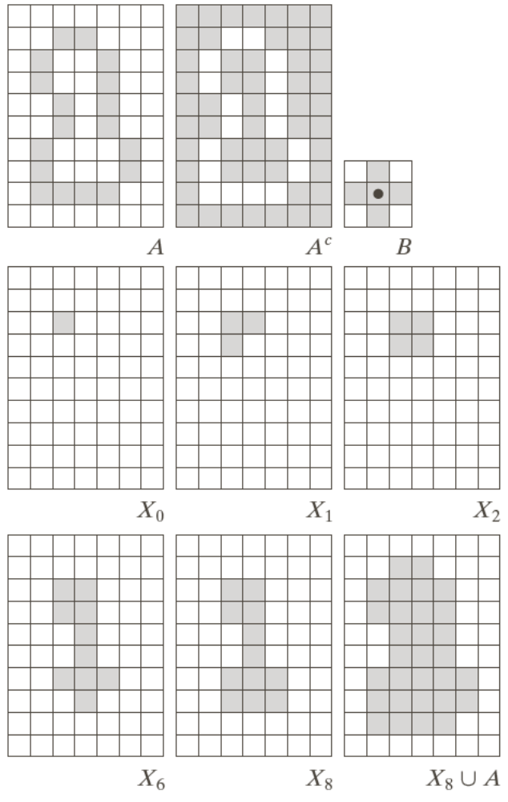
Example

Slide 33

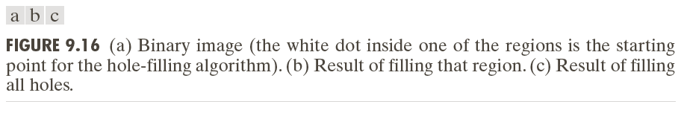

Slide 34
Some Basic Morphological Algorithms (3)
Extraction of Connected Components
Central to many automated image analysis applications.
Let A be a set containing one or more connected components, and form an array X₀ (of the same size as the array containing A) whose elements are 0s, except at each location known to correspond to a point in each connected component in A, which is set to 1.

Slide 35
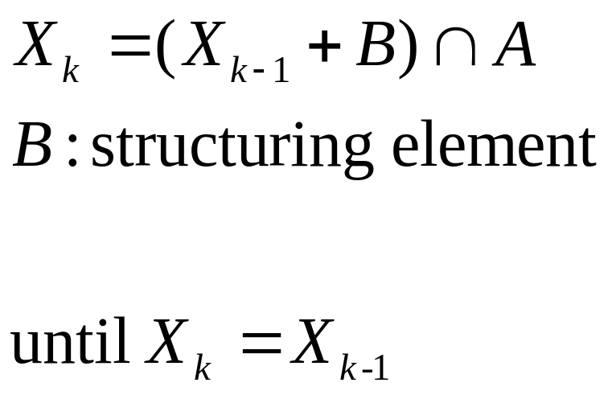
Some Basic Morphological Algorithms (3)
Extraction of Connected Components
Central to many automated image analysis applications.

Slide 36
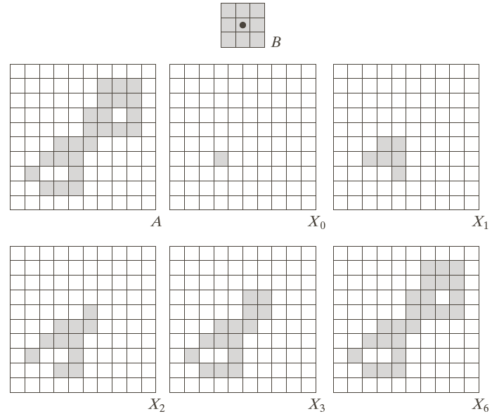
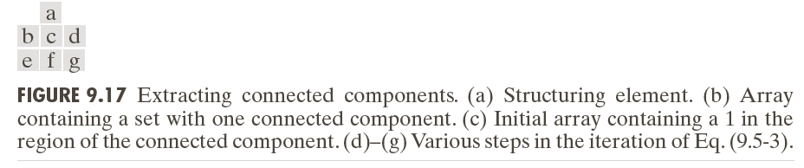

Slide 37
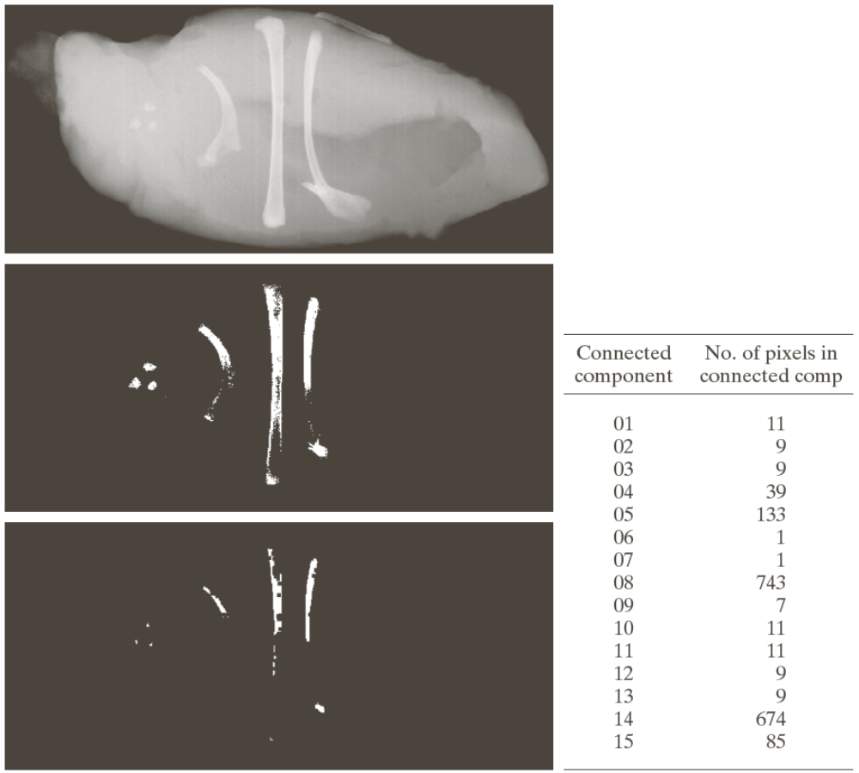
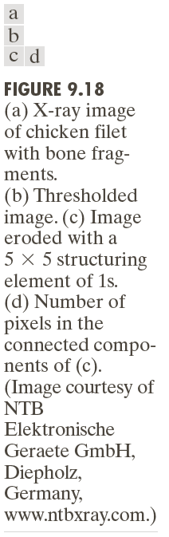

Slide 38
Some Basic Morphological Algorithms (4)
Convex Hull
A set A is said to be convex if the straight line segment joining any two points in A lies entirely within A.
The convex hull H or of an arbitrary set S is the smallest convex set containing S.

Slide 39
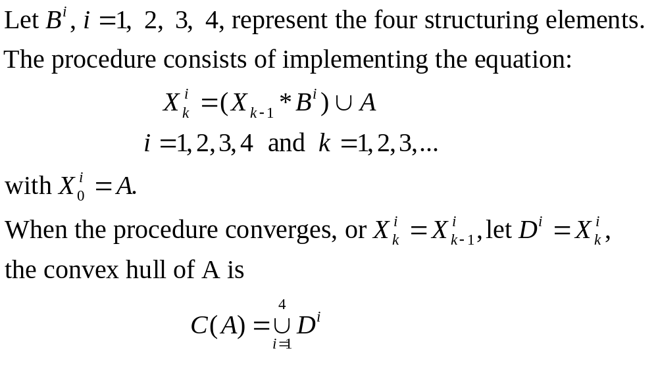
Some Basic Morphological Algorithms (4)
Convex Hull

Slide 41
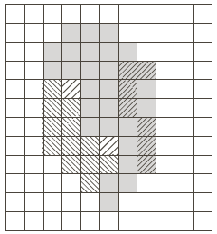
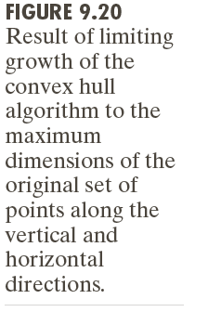

Slide 42
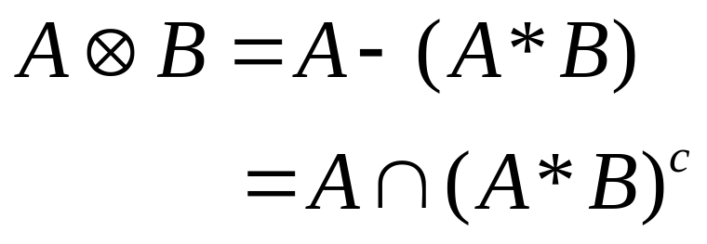
Some Basic Morphological Algorithms (5)
Thinning
The thinning of a set A by a structuring element B, defined

Slide 43
Some Basic Morphological Algorithms (5)
A more useful expression for thinning A symmetrically is based on a sequence of structuring elements:

Slide 44
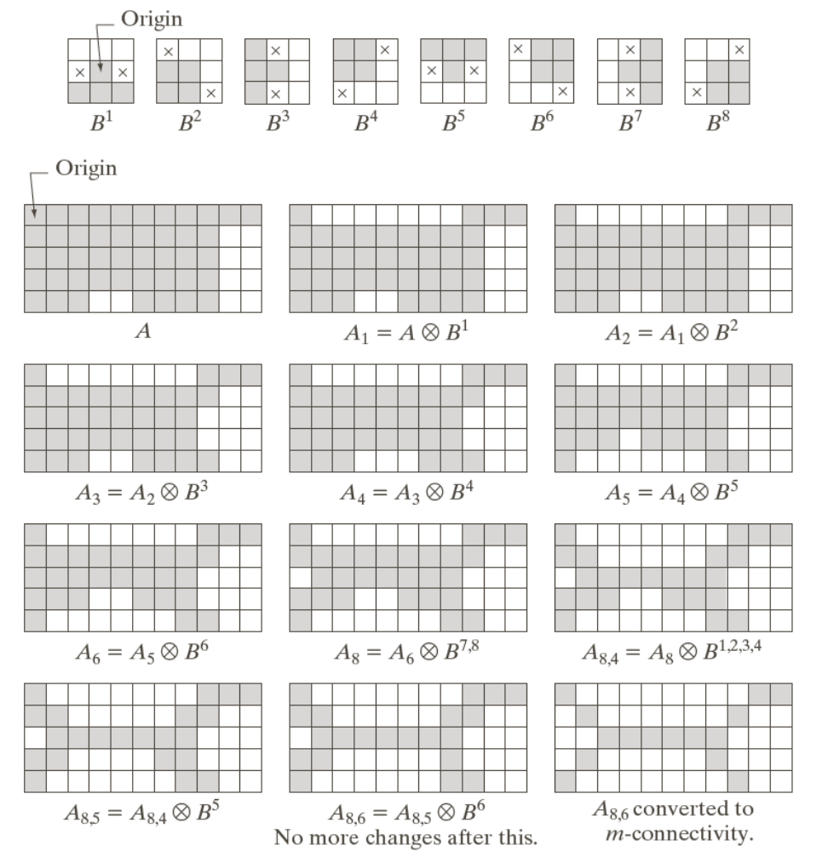
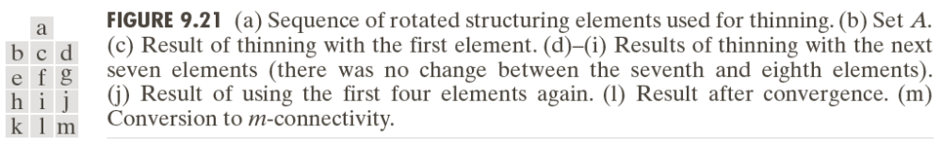

Slide 45



Some Basic Morphological Algorithms (6)
Thickening:

Slide 46



Some Basic Morphological Algorithms (6)

Slide 47

Some Basic Morphological Algorithms (7)
Skeletons

Slide 48

Some Basic Morphological Algorithms (7)

Slide 49

Some Basic Morphological Algorithms (7)

Slide 50


Slide 52

Some Basic Morphological Algorithms (7)

Slide 54

Some Basic Morphological Algorithms (8)
Pruning

Slide 55



Pruning: Example

Slide 56

Pruning: Example

Slide 57

Pruning: Example

Slide 58

Pruning: Example

Slide 59
Pruning: Example

Slide 60

Some Basic Morphological Algorithms (9)
Morphological Reconstruction

Slide 61


Morphological Reconstruction: Geodesic Dilation

Slide 62



Slide 63


Morphological Reconstruction: Geodesic Erosion

Slide 64



Slide 65

Morphological Reconstruction by Dilation

Slide 66



Slide 67

Morphological Reconstruction by Erosion

Slide 68

Opening by Reconstruction

Slide 69



Slide 70

Filling Holes

Slide 71




Slide 72




Slide 73
Border Clearing

Slide 74


Slide 75

Summary (1)

Slide 76

Summary (2)

Slide 77



Slide 78



Slide 79



Gray-Scale Morphology

Slide 80

Gray-Scale Morphology: Erosion and Dilation by Flat Structuring

Slide 81



Slide 82
Gray-Scale Morphology: Erosion and Dilation by Nonflat Structuring

Slide 83

Duality: Erosion and Dilation

Slide 84


Opening and Closing

Slide 85


Slide 86

Properties of Gray-scale Opening

Slide 87

Properties of Gray-scale Closing

Slide 88



Slide 89
Morphological Smoothing
Opening suppresses bright details smaller than the specified SE, and closing suppresses dark details.
Opening and closing are used often in combination as morphological filters for image smoothing and noise removal.

Slide 90

Morphological Smoothing

Slide 91

Morphological Gradient
Dilation and erosion can be used in combination with image subtraction to obtain the morphological gradient of an image, denoted by g,
The edges are enhanced and the contribution of the homogeneous areas are suppressed, thus producing a “derivative-like” (gradient) effect.

Slide 92


Morphological Gradient

Slide 93


Top-hat and Bottom-hat Transformations
The top-hat transformation of a grayscale image f is defined as f minus its opening:
The bottom-hat transformation of a grayscale image f is defined as its closing minus f:

Slide 94
Top-hat and Bottom-hat Transformations
One of the principal applications of these transformations is in removing objects from an image by using structuring element in the opening or closing operation

Slide 95


Example of Using Top-hat Transformation in Segmentation

Slide 96
Granulometry
Granulometry deals with determining the size of distribution of particles in an image
Opening operations of a particular size should have the most effect on regions of the input image that contain particles of similar size
For each opening, the sum (surface area) of the pixel values in the opening is computed

Slide 97

Example

Slide 98


Slide 99
Textual Segmentation
Segmentation: the process of subdividing an image into regions.

Slide 100


Textual Segmentation

Slide 101


Gray-Scale Morphological Reconstruction (1)
Let f and g denote the marker and mask image with the same size, respectively and f ≤ g.
The geodesic dilation of size 1 of f with respect to g is defined as
The geodesic dilation of size n of f with respect to g is defined as

Slide 102


Gray-Scale Morphological Reconstruction (2)
The geodesic erosion of size 1 of f with respect to g is defined as
The geodesic erosion of size n of f with respect to g is defined as

Slide 103


Gray-Scale Morphological Reconstruction (3)
The morphological reconstruction by dilation of a gray-scale mask image g by a gray-scale marker image f, is defined as the geodesic dilation of f with respect to g, iterated until stability is reached, that is,
The morphological reconstruction by erosion of g by f is defined as

Slide 104


Gray-Scale Morphological Reconstruction (4)
The opening by reconstruction of size n of an image f is defined as the reconstruction by dilation of f from the erosion of size n of f; that is,
The closing by reconstruction of size n of an image f is defined as the reconstruction by erosion of f from the dilation of size n of f; that is,

Slide 105



Slide 106


Steps in the Example
Opening by reconstruction of the original image using a horizontal line of size 1x71 pixels in the erosion operation
Subtract the opening by reconstruction from original image
Opening by reconstruction of the f’ using a vertical line of size 11x1 pixels
Dilate f1 with a line SE of size 1x21, get f2.

Slide 107

Steps in the Example
Calculate the minimum between the dilated image f2 and and f’, get f3.
By using f3 as a marker and the dilated image f2 as the mask,

